Slide 1


Slide 2
Student Management System
Project Report
Data Structures & Algorithm | CSE 207
Department of Computer Science & Engineering

Slide 3

Student Details & Group Members
Name
Roll Number
Email
MD MEHEDI HASAN NIRJON
2023-2-60-113
2023-2-60-113@STD.EWUBD.EDU
Individual project report for the "Student Management System" project in Data Structures (CSE 207).

Slide 4
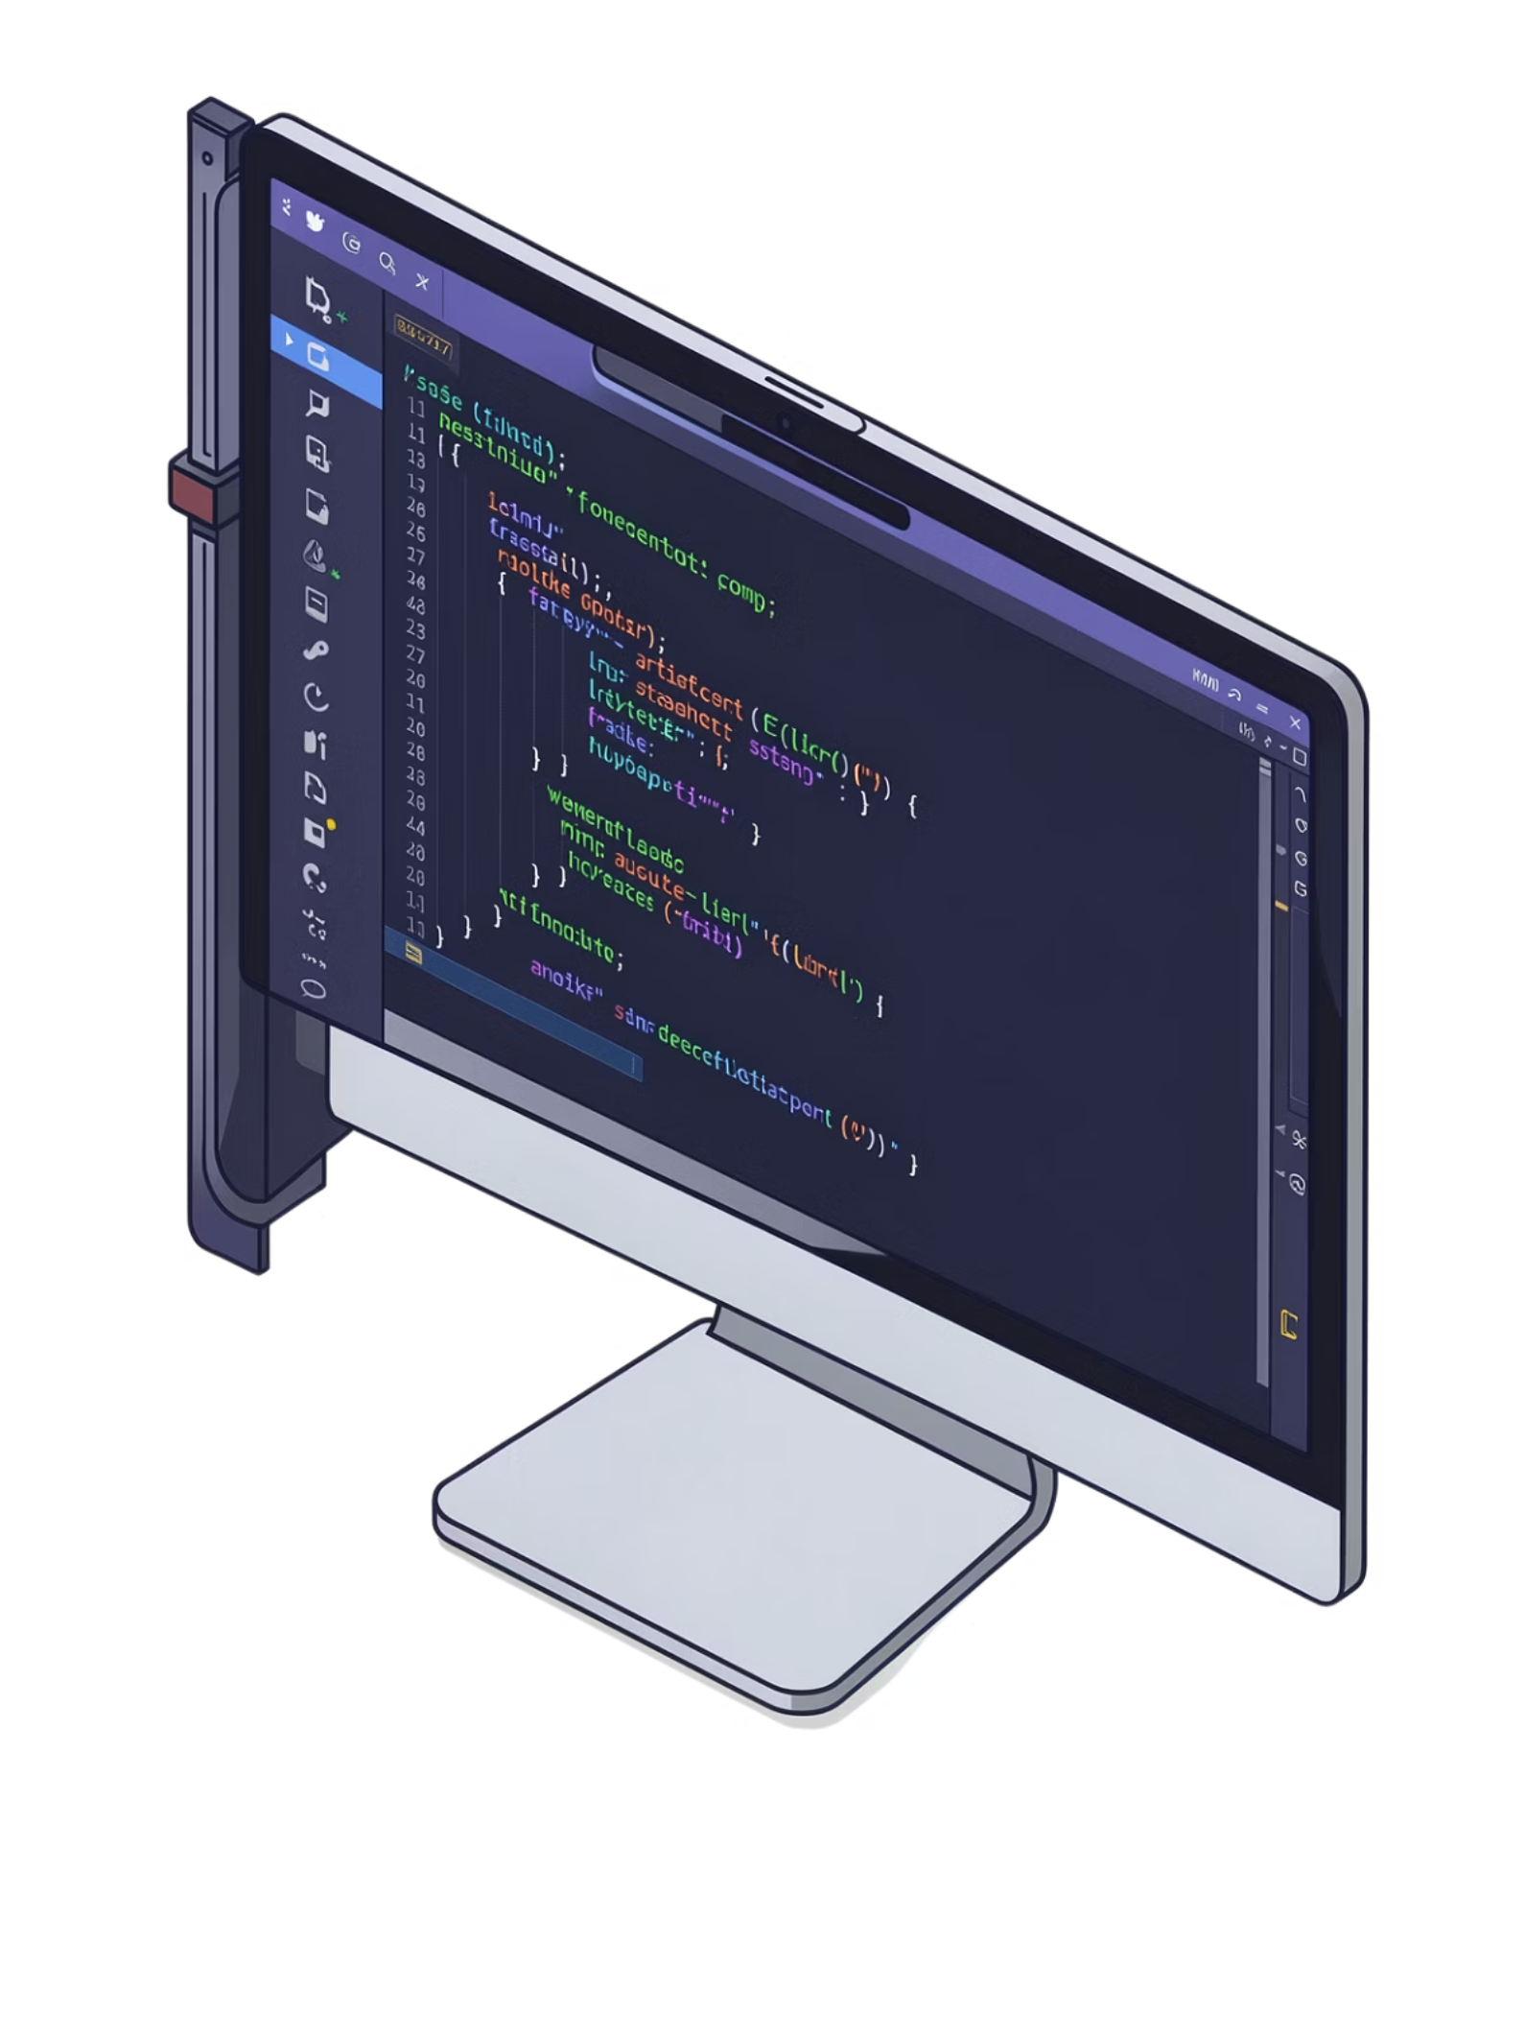
Header Files & Namespace
The program begins by including the essential C++ standard libraries that power every feature of the system.
#include <iostream>
Standard input/output streams for console interaction.
#include <fstream>
File stream support for persistent data storage.
#include <cstdlib>
General utilities including system() and exit().
#include <conio.h>
Console I/O for getch() keypress handling.
#include <iostream>
#include <cstdlib>
#include <conio.h>
#include <fstream>
using namespace std;

Slide 5
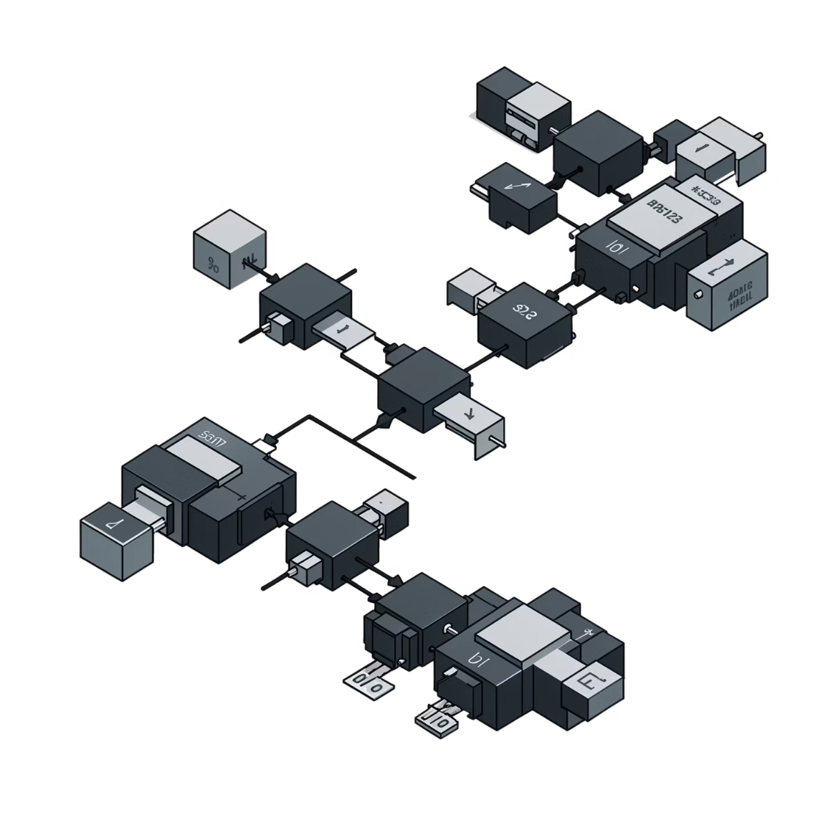

class Node{
public:
int roll_no;
string name;
float marks, per;
Node* next;
};
class Node
The Node class is the fundamental building block of the singly linked list. Each node stores one student's complete record and a pointer to the next node in the chain.
roll_no (int)
name (string)
marks / per (float)
next (Node*)
Unique student identifier.
Student's full name.
Marks obtained and percentage value.
Pointer linking to the next node.

Slide 6

loadFromFile() and saveToFile()
These two functions provide persistent storage — student records survive between program sessions by reading from and writing to students.txt.
void loadFromFile() {
ifstream file("students.txt");
if(!file) { return; }
int r;
string n;
float m, p;
while(file >> r >> n >> m >> p) {
Node* newNode = new Node;
newNode->roll_no = r;
newNode->name = n;
newNode->marks = m;
newNode->per = p;
newNode->next = nullptr;
if(head == nullptr) {
head = newNode;
} else {
Node* temp = head;
while(temp->next != nullptr)
temp = temp->next;
temp->next = newNode;
}
}
file.close();
}
void saveToFile() {
ofstream file("students.txt");
Node* temp = head;
while(temp != nullptr) {
file << temp->roll_no
<< " " << temp->name
<< " " << temp->marks
<< " " << temp->per
<< "\n";
temp = temp->next;
}
file.close();
}
Load From File
Save To File

Slide 7
void insert()
Adds a new student record to the end of the linked list. Includes duplicate roll number detection before insertion.
void insert(){
int r; string n; float m;
cout << "\n\nENTER ROLL NO. : ";
cin >> r;
Node* checkDuplicate = head;
while(checkDuplicate != nullptr){
if(checkDuplicate->roll_no == r){
cout << "\n\nSTUDENT WITH THIS ROLL NO. ALREADY EXISTS!!";
return;
}
checkDuplicate = checkDuplicate->next;
}
cout << "\n\nENTER NAME : "; cin >> n;
cout << "\n\nENTER MARKS : "; cin >> m;
Node* newNode = new Node;
newNode->roll_no = r; newNode->name = n;
newNode->marks = m; newNode->per = m;
newNode->next = nullptr;
if(head == nullptr){ head = newNode; }
else{
Node* temp = head;
while(temp->next != nullptr) temp = temp->next;
temp->next = newNode;
}
cout << "\n\nNEW NODE INSERTED SUCCESSFULLY!!!";
}

Slide 8

void search() and void count()
search() — Find by Roll No.
count() — Total Node Count
void search(){
if(head==nullptr){
cout<<"\n\nLINKED LIST IS EMPTY!!!";
} else {
int r, found=0;
cout<<"\n\n ENTER ROLL NO. : ";
cin>>r;
Node* temp=head;
while(temp!=nullptr){
if(r==temp->roll_no){
cout<<"\n\n ROLL NO. : "<<temp->roll_no;
cout<<"\n\n NAME : "<<temp->name;
cout<<"\n\n MARKS : "<<temp->marks;
cout<<"\n\n PERCENTAGE : "<<temp->per;
found++;
}
temp=temp->next;
}
if(found==0)
cout<<"\n\nNO RESULTS FOUND!!!";
}
}
void count(){
if(head==nullptr){
cout<<"\n\nLINKED LIST IS EMPTY!";
} else {
int cnt=0;
Node* temp=head;
while(temp!=nullptr){
cnt++;
temp=temp->next;
}
cout<<"\n\n TOTAL NUMBER OF NODES : "
<<cnt<<endl;
}
}
Both functions traverse the full linked list using a temp pointer — O(n) time complexity.

Slide 9
void update() and void deletion()
update()
deletion()
void update(){
if(head==nullptr){
cout<<"\n\nLINKED LIST IS EMPTY!!!";
} else {
int r, found=0;
cout<<"\n\n ENTER ROLL NO. : "; cin>>r;
Node* temp=head;
while(temp!=nullptr){
if(r==temp->roll_no){
cout<<"\n\nENTER NEW ROLL NO. : ";
cin>>temp->roll_no;
cout<<"\n\n ENTER NAME : ";
cin>>temp->name;
cout<<"\n\n ENTER MARKS : ";
cin>>temp->marks;
temp->per=temp->marks;
cout<<"\n\nRECORD UPDATED SUCCESSFULLY!";
found++; break;
}
temp=temp->next;
}
if(found==0)
cout<<"\n\nNO RESULTS FOUND!!!";
}
}
void deletion(){
if(head==nullptr){
cout<<"\n\nLINKED LIST IS EMPTY!!!";
} else {
int r, found=0;
cout<<"\n\n ENTER ROLL NO. : "; cin>>r;
if(r==head->roll_no){
Node* temp=head;
head=head->next;
found++; delete temp;
cout<<"\n\nRECORD DELETED SUCCESSFULLY!!";
} else {
Node* prev=head;
Node* temp=head->next;
while(temp!=nullptr){
if(r==temp->roll_no){
prev->next=temp->next;
found++; delete temp; break;
}
prev=temp; temp=temp->next;
}
}
if(found==0)
cout<<"\n\nNO RESULTS FOUND!!!";
}
}

Slide 10
void show()
Traverses the entire linked list and prints every student record to the console in a formatted layout.
Output Format
void show() {
if (head == nullptr) {
cout << "\n\nLINKED LIST IS EMPTY!!!";
} else {
Node* temp = head;
cout << "\n\n======== ALL RECORDS ========";
while (temp != nullptr) {
cout << "\n\n ROLL NO. : " << temp->roll_no;
cout << "\n NAME : " << temp->name;
cout << "\n MARKS : " << temp->marks;
cout << "\n PERCENTAGE : " << temp->per << "%";
cout << "\n-----------------------------";
temp = temp->next;
}
}
}
Each record is printed with consistent field labels and separated by a dashed divider line for readability.
Iterates with a temp pointer from head
Prints Roll No., Name, Marks, and Percentage
Dashed separator between each record
Handles empty list with a clear error message

Slide 11
int main()
The entry point loads persisted data, then runs a goto-driven menu loop dispatching all six operations via a switch statement.
int main(){
int choice;
Linked_List obj;
obj.loadFromFile();
p:
system("cls");
cout<<"\n\n============================="<<endl;
cout<<"\t STUDENT MANAGEMENT SYSTEM"<<endl;
cout<<"============================="<<endl;
cout<<"\n\n1. ADD NEW STUDENT";
cout<<"\n\n2. SEARCH";
cout<<"\n\n3. COUNT TOTAL STUDENT ID";
cout<<"\n\n4. UPDATE RECORD";
cout<<"\n\n5. DELETE STUDENT RECORD";
cout<<"\n\n6. SHOW ALL RECORD";
cout<<"\n\n7. EXIT";
cout<<"\n\nPLEASE CHOOSE YOUR OPTION : ";
cin>>choice;
switch(choice){
case 1: obj.insert(); break;
case 2: obj.search(); break;
case 3: obj.count(); break;
case 4: obj.update(); break;
case 5: obj.deletion(); break;
case 6: obj.show(); break;
case 7:
obj.saveToFile();
cout<<"THANK YOU FOR USING THE SYSTEM!!"<<endl;
exit(0);
default:
cout<<"\n\nPLEASE ENTER A VALID VALUE!!!"<<endl;
}
getch(); goto p;
}
01
Load Data
loadFromFile() restores records from students.txt into the linked list on startup.
02
Display Menu
Console menu presents 7 options. User enters a choice integer.
03
Dispatch via switch
Each case calls the corresponding method on the Linked_List object.
04
Loop or Exit
getch() pauses, then goto p restarts the menu. Case 7 saves and exits.

Slide 12
Project Conclusion: Student Management System
This project demonstrates the practical application of C++ and fundamental data structures to create a robust student record management system.
Dynamic Record Management
Comprehensive CRUD Operations
Utilized a singly linked list for efficient and flexible student data handling.
Implemented full Create, Read, Update, Delete (CRUD) functionality.
Persistent Data Storage
Interactive Command-Line Interface
Ensured data integrity and retention via file operations (loadFromFile(), saveToFile()).
Provided a user-friendly, menu-driven interface for system interaction.
This system showcases how data structures and algorithms form the backbone of real-world applications, emphasizing key software engineering principles.

Slide 13
THANK YOU
We appreciate your time and valuable feedback throughout this project.
MD MEHEDI HASAN NIRJON (2023-2-60-113)
Notes:
Deliver the thank you message sincerely, making eye contact. Briefly mention future plans if applicable.

